Slide 1
FIRST Robotics
Now Playing!

Slide 2
Who Am I
Keith E. Kelly CIT Developer Program Northwestern Michigan College Traverse City, MI kkelly@nmc.edu
Background
Electronics
Programming
CIT Developer Program
First Mentor – Team 1711

Slide 3
Objectives
What is FIRST?
Leadership and Support
Programs
First Robotics Challenge
Updates from the Current Season
Learning Opportunities

Slide 4
What is FIRST?
Public charity - founded 1989
Vision
"To transform our culture by creating a world where science and technology are celebrated and where young people dream of becoming science and technology leaders."
Mission
Our mission is to inspire young people to be science and technology leaders, by engaging them in exciting mentor-based programs that build science, engineering and technology skills, that inspire innovation, and that foster well-rounded life capabilities including self-confidence, communication, and leadership.

Slide 5
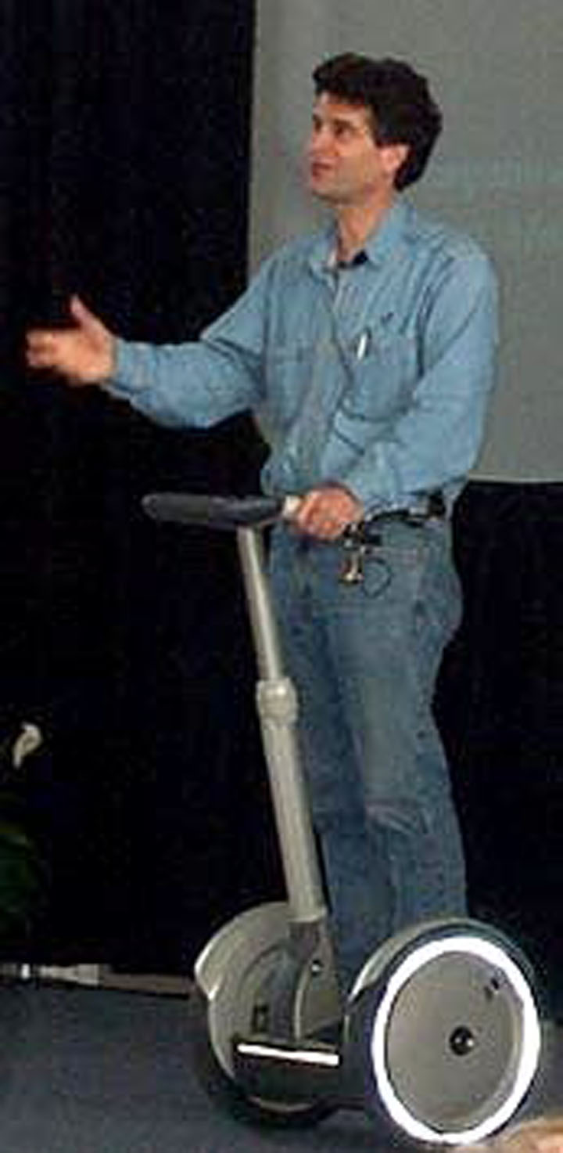
Leadership and Support
Dean L. Kamen - President, DEKA Research and Development Corporation
Inventor, entrepreneur
Advocate for science and technology
Founded FIRST in 1989 to inspire young people's interest and participation in science and technology.
Public charity designing accessible, innovative programs that motivate young people to pursue education and career opportunities in science, technology, engineering, and math.

Slide 6
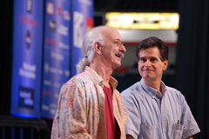
FIRST Values
Gracious Professionalism
Coined by Dr. Woodie, Flowers, Professor Emeritus MIT
encourages high-quality work
emphasizes the value of others
respects individuals and the community.
fierce competition and mutual gain are not separate notions
Coopertition
displaying unqualified kindness and
respect in the face of fierce
competition.

Slide 7
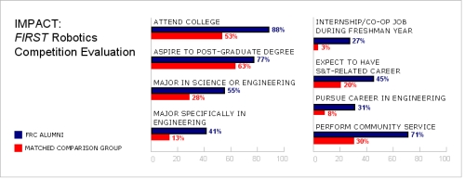
Impact
Brandeis University Study - FIRST Robotics Competition
Compared FRC participants to non-FIRST group with similar backgrounds, including math and science.
More than 3 times as likely to major specifically in engineering.
Roughly 10 times as likely to have had an apprenticeship, internship, or co-op job in their freshman year.
More than twice as likely to expect to pursue a career in science and technology.

Slide 8
Overall Reach
All Programs Combined (2010/11 season)
248,000+ students
22,467 teams
20,667 robots
66,000+ mentors/adult supporters
33,000+ event volunteers

Slide 9
2011 FIRST Scholarship Program
More than $14 million in college scholarships
888 individual offerings
134 scholarship providers

Slide 10
Programs
FIRST Robotics Competition for Grades 9-12 (ages 14-18)
2,070+ teams
Robots are built in 6 weeks from a common kit of parts provided by FIRST, and weigh up to 120 lbs.
FIRST Tech Challenge for Grades 9-12 (ages 14-18)
1,500 teams
Robots are built using a modular robotics platform

Slide 11
Programs
FIRST LEGO League for Grades 4-8 (ages 9-16; 9-14 in the U.S. and Canada)
17,100 teams
Robots are built using LEGO MINDSTORMS technologies
Junior FIRST LEGO League for Grades K-3 (ages 6-9)
1,800 teams
Participants design and construct a model using LEGO bricks and moving parts and present their research on a poster

Slide 12
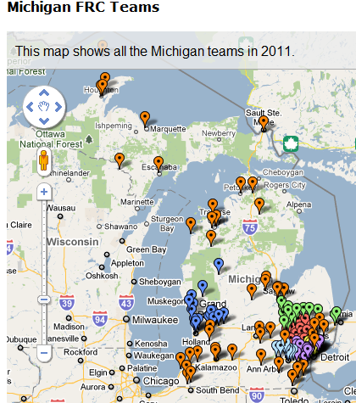
FRC Teams in Michigan

Slide 13
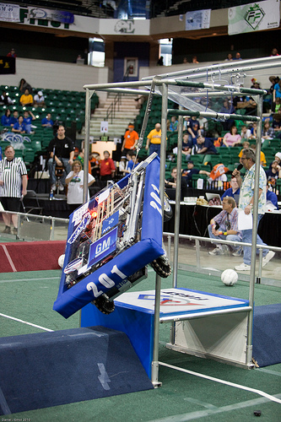
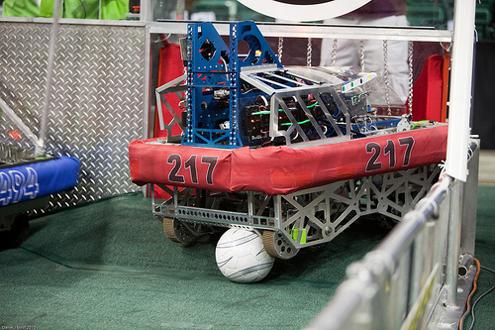
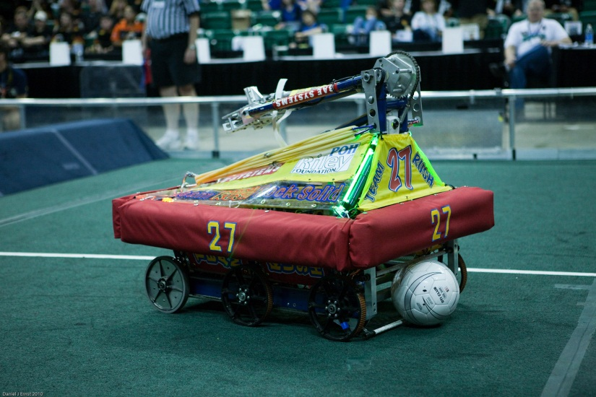
Michigan Robots – 2010 Game

Slide 14
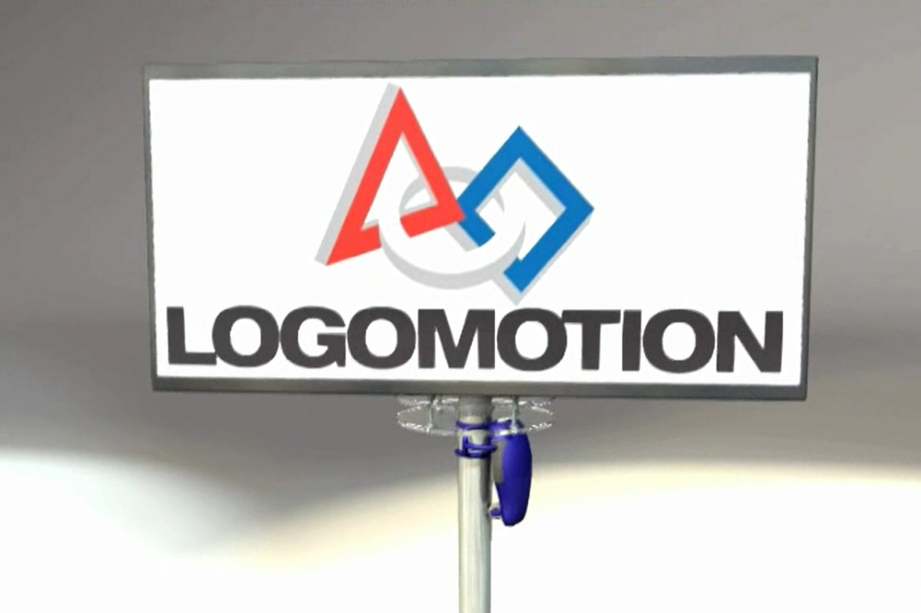
Now Playing - Logomotion

Slide 15
3 Weeks and Counting
Mentoring topics – so far!
Magnetics
Coefficient of Friction
Torque
Motor design
Electrical power
PID Controllers and broom handles
Java base classes
Private, Public, and Protected Variables
Programming Delays and Threads
Tank Drive and Moment arms

Slide 16
Team Updates
http://sites.google.com/site/1711raptors/
http://www.youtube.com/results?search_query=frc+2011+minibot&aq=f

Slide 17
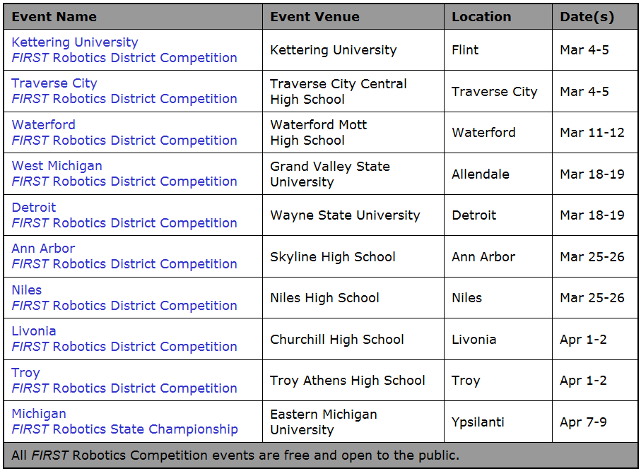
Michigan 2011 Events

Slide 18
More Information
www.USFirst.org
www.FirstInMichigan.org
http://www.youtube.com/user/FIRSTWorldTube#p/c/F952898665788873/22/zyavvQEDYW0

