Slide 1
Program Evaluation Using Microsoft’s MTA Certification
Session A13
Notes:
Show first robotics video

Slide 2
Keith E. Kelly CIT Developer Program Northwestern Michigan College Traverse City, MI kkelly@nmc.edu http://www.linkedin.com/in/keithekelly LinkedIn Group - Microsoft Technology Associate

Slide 3
Our Topics…
IT Certification – Why?
Program of Study - CIT Developer Program
Discuss Third-Party Assessment and Articulation
Overview of MTA Certification
Integration of MTA – Program Review
Getting Started with MTA
Notes:
Who is in the audience?

Slide 4
Industry Certification in IT
Report Published in 2000
NMC Transition
CIT
CIS
IT
DEV
IT = CIT Infrastructure (networking)
DEV = Software Developer

Slide 5
Industry Certification – Why?
International Credential for Students
Employers Value Certification
From Keynote Session $37K vs $31K
Standardized Outcomes
Applies Versioning to Knowledge
Provides Perkins “Indicators of Performance and Accountability”
Simplifies Articulation
Increased Completion Rates
∆ Facilitates Program Review

Slide 6
IT - Infrastructure Program
Integrated Certifications
CompTIA
A+
Net+
Security+
Microsoft – MCTS
Cisco - CCNA

Slide 7
Developer Program
Job Titles - programmer, software engineer, developer
Job Outlook – Recent NACE Top 10 List
#2 - Web Developer
#5 – Computer Software Engineer
Bureau of Labor Statistics
Largest Growth
Fastest Growth
Mobile Phone Apps!
Notes:
Pocket computer
Embedded – how many computers

Slide 8
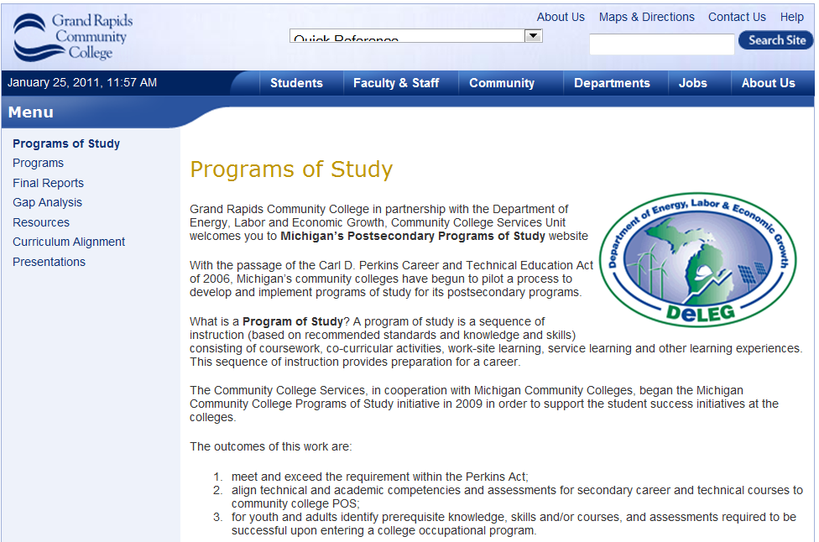
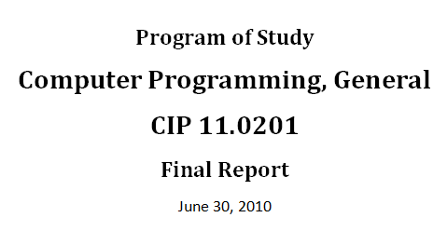
Program of Study Grant Project
www.grcc.edu/programsofstudy

Slide 9
POS - Gaps Identified
No Secondary Programs
Math Prerequisite
Industry Certification?

Slide 10
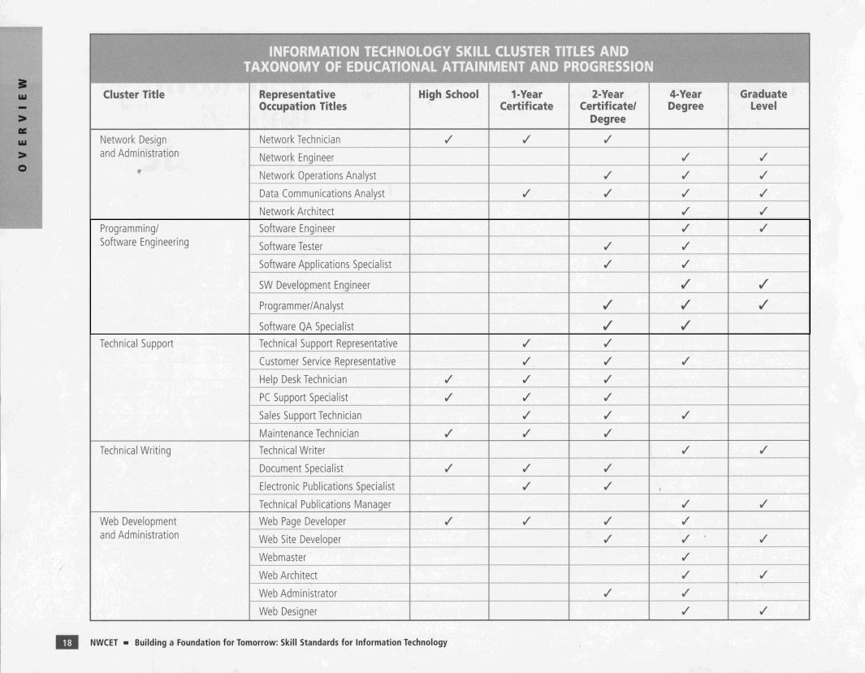
A Post-Secondary Program?

Slide 11
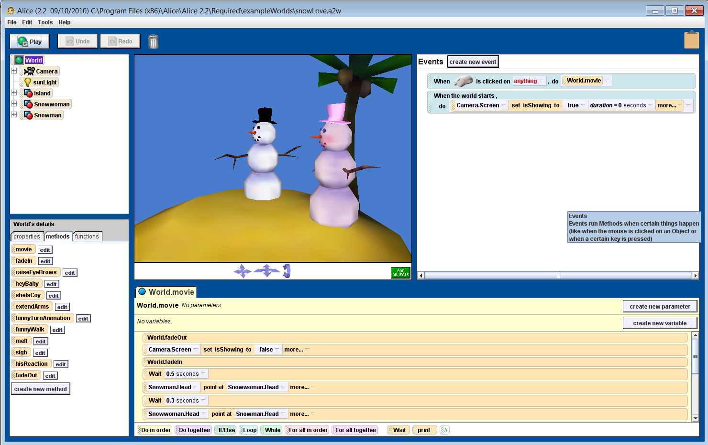
Software Fundamentals w/ Alice

Slide 12
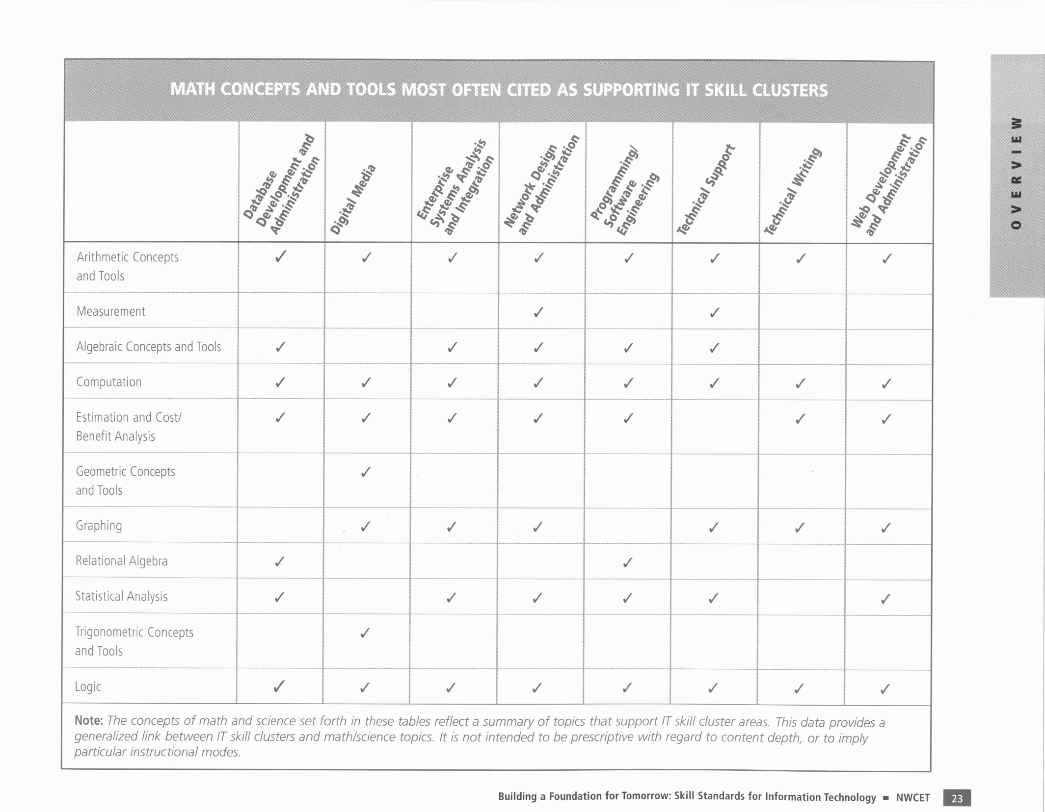
Math Requirements

Slide 13
Industry Certification?
Standardized on Microsoft .NET
Certification?
Microsoft Certified Technology Specialist?
Good programmers
are good architects.
Syntax and class libraries
are less important.”

Slide 14
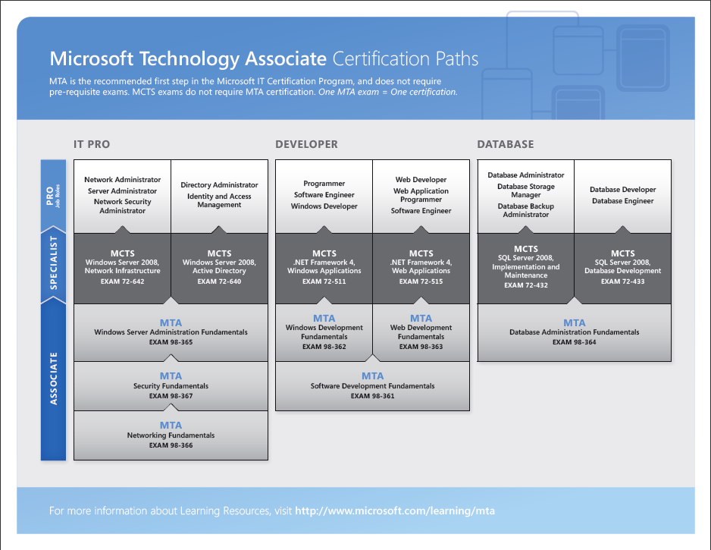

Slide 15
IT Pro – Objective Domain
98-366 - Networking Fundamentals
Understanding Network Infrastructures
Understanding Network Hardware
Understanding Protocols and Services
98-367 -Security Fundamentals
Understanding Security Layers
Understanding Operating System Security
Understanding Network Security
Understanding Security Software
98-365 - Windows Server Administration Fundamentals
Understanding Server Installation
Understanding Server Roles
Understanding Active Directory
Understanding Storage
Understanding Server Performance Management
Understanding Server Maintenance

Slide 16
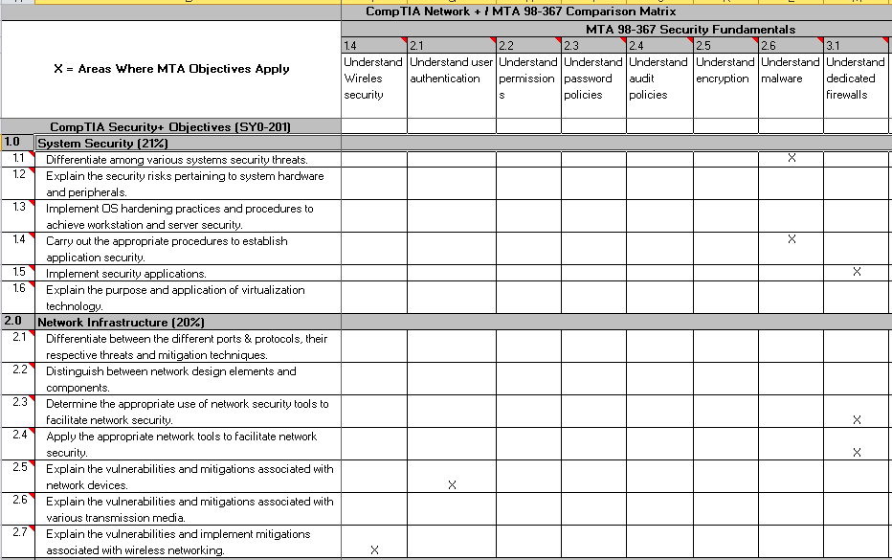
CompTIA Comparison Matrix

Slide 17
CompTIA Comparison Summary
“Although the MTA exams objectives are not as comprehensive at the CompTIA objectives, I do see a benefit. The MTA certification exam will be a good “readiness” tool. If they are unable to pass this exam, then it’s doubtful they will pass the CompTIA exam. It can also be used as a “litmus” test to see if Networking Technology is the right program for the student.”
- Scott Goethals, NMC CIT Program Coordinator

Slide 18
MTA Dev/Data Objectives
98-361 - Software Development Fundamentals
Understanding Core Programming
Understanding Object-Oriented Programming
Understanding General Software Development
Understanding Web Applications
Understanding Desktop Applications
Understanding Databases

Slide 19
MTA Dev/Data Objectives
98-362 - Windows Development Fundamentals
Understanding Windows Programming Basics
Creating Windows Forms Applications
Creating Windows Services Applications
Accessing Data in a Windows Forms Application
Deploying a Windows Application

Slide 20
MTA Dev/Data Objectives
98-363- Web Development Fundamentals
Programming Web Applications
Working with Data and Services
Troubleshooting and Debugging Web Applications
Working with Client-Side Scripting
Configuring and Deploying Web Applications

Slide 21
MTA Dev/Data Objectives
98-364 - Database Administration Fundamentals
Understanding Core Database Concepts
Creating Database Objects
Manipulating Data
Understanding Data Storage
Administering a Database

Slide 22
Industry Certification – Why?
International Credential for Students
Employers Value Certification
Standardized Outcomes
Applies Versioning to Knowledge
Provides Perkins “Indicators of Performance and Accountability”
Increased Completion Rates
∆ Program Review

Slide 23
PDCA Quality Cycle
ADJUST
PLAN
CHECK
DO

Slide 24
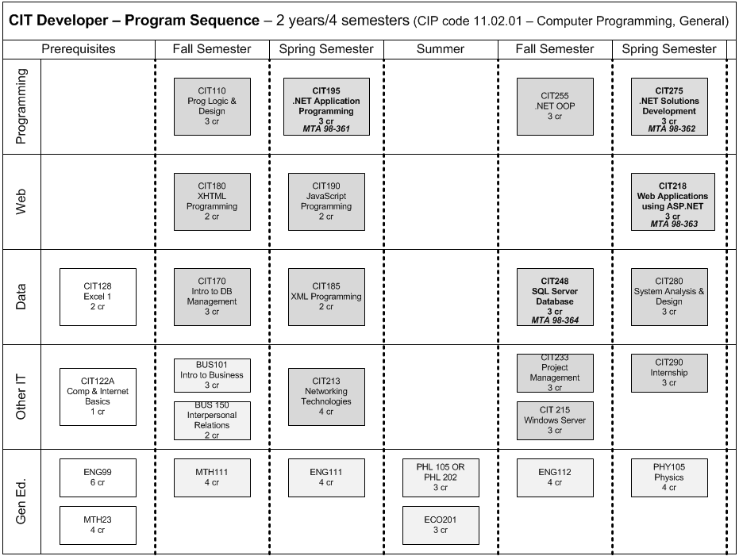
Plan and Do

Slide 25
Select Preview - Pilot
Exam 98-364 required for all CIT248 – SQL Server students
Existing course work
Certiport group created
Exams completed and aggregated data reported

Slide 26
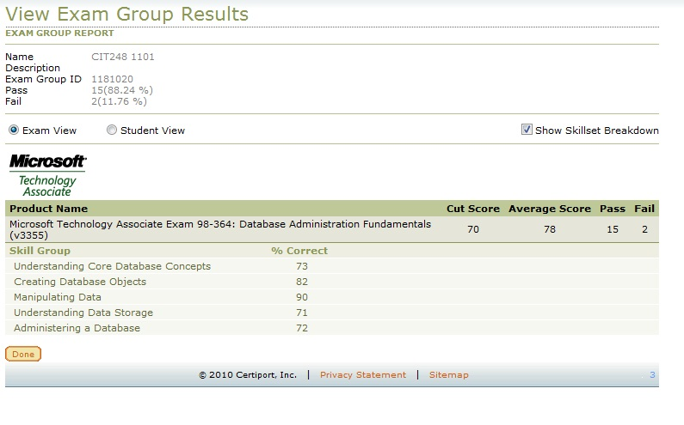
Check and Adjust

Slide 27
Impact and Results
How big is the box?

Slide 28
Impact and Results
How big is the box?
What is required content for a beginning programmer?
Certifications provide clearly defined outcomes
Internationally recognized

Slide 29
Impact and Results
Content Externally Validated
IT Industry Sets the Standard
Much of the Content is Vendor Neutral

Slide 30
Impact and Results
Changing Instructor Roles

Slide 31
Impact and Results
Introduction to Certification
Microsoft Transcript

Slide 32
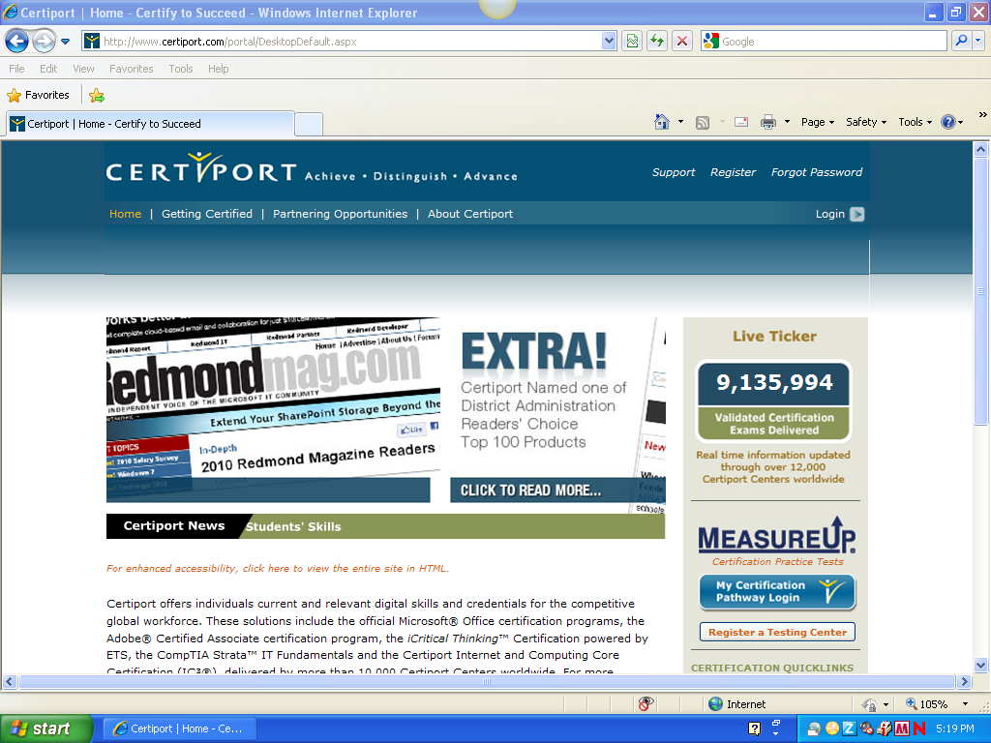
MTA - How To…

Slide 33
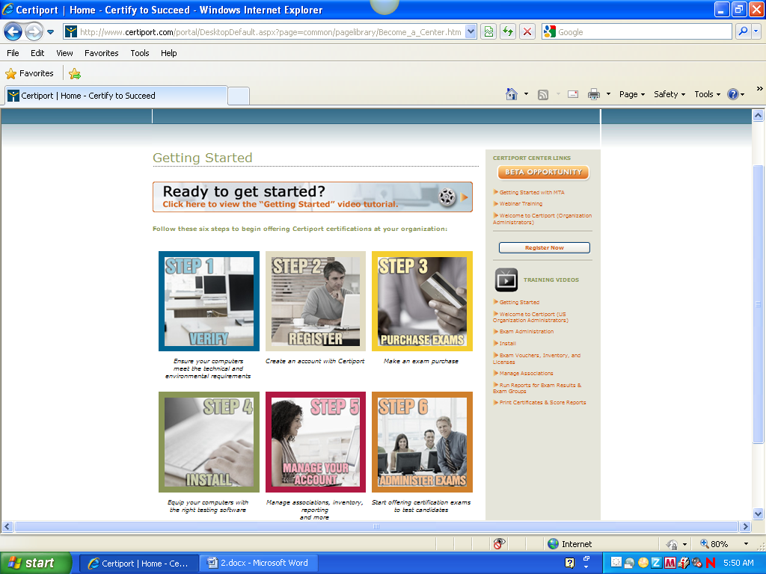
Certiport Testing Center

Slide 34
MTA Certification Cost
Country | Local Currency | Site License | ITA Site License | Voucher | ITA Voucher
USA | Dollar | $ 3,000 | $ 2,550 | $ 47.00 | $ 40.00
* Five Free Vouchers – Provide contact information to Keith

Slide 35
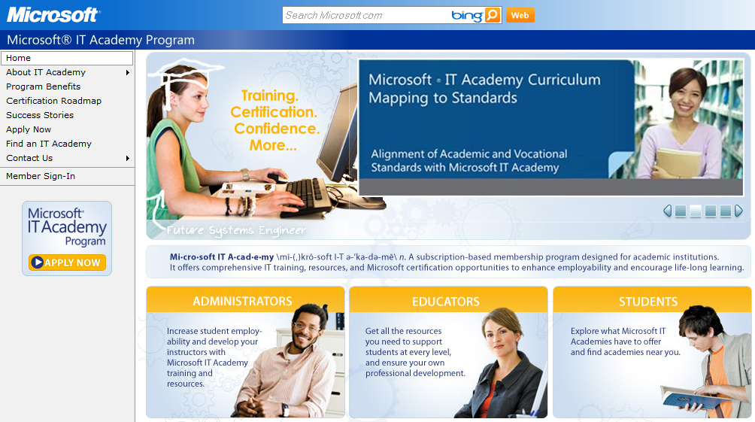
Microsoft IT Academy

Slide 36
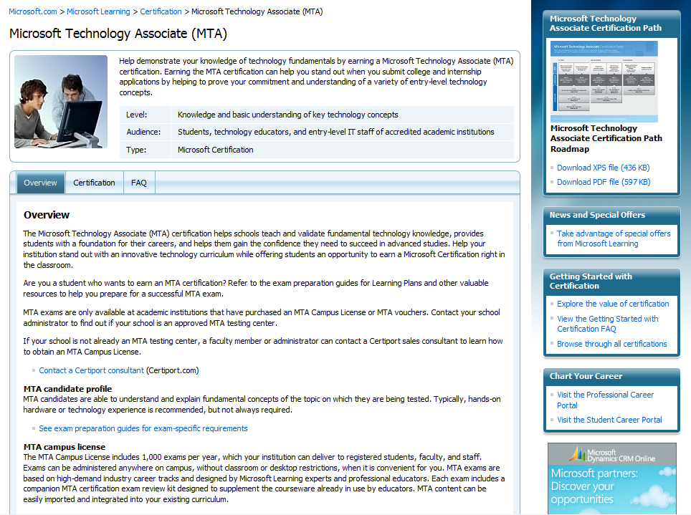

Slide 37
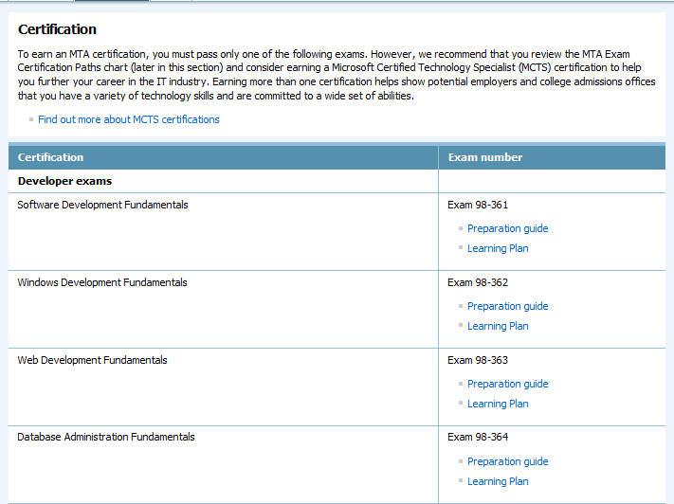

Slide 38
Wrap up – NMC Strategic Directions
NMC will establish national and international competencies in select areas connected to the regional economy and assets.
NMC will ensure that learners are prepared for success in a global society and economy.
NMC will transcribe most learning to establish credentials of value.

Slide 39
NMC Learning Model
What are the cultural factors that support learning? (Culture)
What is it we expect all students to know and be able to do and what are the dispositions (attitudes, traits, virtues) they will develop? (Curriculum)
How will students (and we) know that they’ve learned these things? (Assessment)
What instructional practices work? (Instruction)
What are we prepared to do for students who need more? (Intervention)

Slide 40
Questions?
Keith E. Kelly
Northwestern Michigan College
kkelly@nmc.edu
LinkedIn.com/in/KeithEKelly
LinkedIn Group - Microsoft Technology Associate

